Slide 1
Cornerstone City Church Peninsula Plus Community Hoo Are Ya
29th February 2026

Slide 2
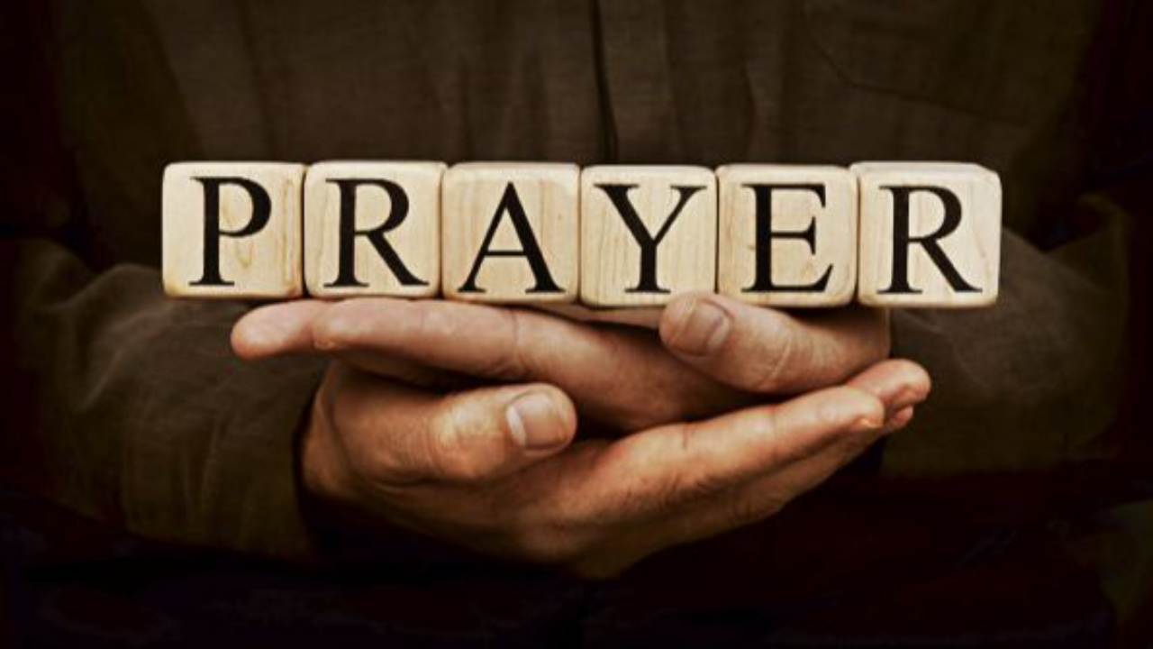

Slide 3
Living Hope CCLI Song # 7106807
Brian Johnson | Phil Wickham
© 2017 Phil Wickham Music; Simply Global Songs; Sing My Songs; Bethel Music Publishing
For use solely with the SongSelect® Terms of Use. All rights reserved. www.ccli.com
CCLI Licence No. 33265

Slide 4
1/6
How great the chasm that lay between us
How high the mountain I could not climb
In desperation I turned to heaven
And spoke Your name into the night
Then through the darkness Your loving-kindness
Tore through the shadows of my soul
The work is finished the end is written
Jesus Christ my living hope

Slide 5
2/6
Who could imagine so great a mercy
What heart could fathom such boundless grace
The God of ages stepped down from glory
To wear my sin and bear my shame
The cross has spoken I am forgiven
The King of kings calls me His own
Beautiful Savior I’m Yours forever
Jesus Christ my living hope

Slide 6
3/6
Hallelujah praise the One who set me free
Hallelujah death has lost its grip on me
You have broken every chain
There’s salvation in Your name
Jesus Christ my living hope

Slide 7
4/6
Then came the morning that sealed the promise
Your buried body began to breathe
Out of the silence the Roaring Lion
Declared the grave has no claim on me
(REPEAT)
Jesus Yours is the victory whoa

Slide 8
5/6
Hallelujah praise the One who set me free
Hallelujah death has lost its grip on me
You have broken every chain
There’s salvation in Your name
Jesus Christ my living hope

Slide 9
6/6
Jesus Christ my living hope
Oh God You are my living hope

Slide 10
O Come To The Altar
CCLI Song # 7051511
Chris Brown | Mack Brock | Steven Furtick | Wade Joye
© 2015 Music by Elevation Worship Publishing
For use solely with the SongSelect® Terms of Use. All rights reserved. www.ccli.com
CCLI Licence No. 33265

Slide 11
1/7
Are you hurting and broken within
Overwhelmed by the weight of your sin
Jesus is calling
Have you come to the end of yourself
Do you thirst for a drink from the well
Jesus is calling

Slide 12
2/7
O come to the altar
The Father's arms are open wide
Forgiveness was bought with
The precious blood of Jesus Christ

Slide 13
3/7
Leave behind your regrets and mistakes
Come today there's no reason to wait
Jesus is calling
Bring your sorrows and trade them for joy
From the ashes a new life is born
Jesus is calling

Slide 14
4/7
O come to the altar
The Father's arms are open wide
Forgiveness was bought with
The precious blood of Jesus Christ (REPEAT)

Slide 15
5/7
Oh what a Savior
Isn't he wonderful
Sing alleluia Christ is risen
Bow down before him
For he is Lord of all
Sing alleluia Christ is risen

Slide 16
6/7
O come to the altar
The Father's arms are open wide
Forgiveness was bought with
The precious blood of Jesus Christ

Slide 17
7/7
Bear your cross as you wait for the crown
Tell the world of the treasure you've found

Slide 19
Endless Praise
CCLI Song # 7183423
Charity Gayle | Crystal Yates | David Gentiles | Ryan Kennedy | Steven Musso
© 2021 Brother Gayle Hymnal; Come Up Kings Publishing; Awaken Love Music; ComissionMusic; Steven Musso Music
For use solely with the SongSelect® Terms of Use. All rights reserved. www.ccli.com
CCLI Licence No. 33265

Slide 20
1/6
I can’t wait for eternity
Join the song they're already singing
Holy holy holy are You Lord
Just to bow down before Your throne
See Your face I’ll cry out because You’re
Holy holy holy are You Lord

Slide 21
2/6
Jesus King of Kings
Jesus Majesty

Slide 22
3/6
Standing with those who have heard well done
Proclaiming forever that You’re the One who’s
Faithful faithful faithful are You Lord
What can we give You but endless praise
The heavens roar as we shout Your name is
Jesus Jesus Jesus You are Lord

Slide 23
4/6
Jesus King of Kings
Jesus Majesty

Slide 24
5/6
Worthy worthy worthy Lord
Another glimpse of glory
We sing once more
Worthy worthy worthy Lord
Forever (forever)

Slide 25
6/6
Jesus King of Kings
Jesus Majesty

Slide 26
All Hail King Jesus CCLI Song # 7097216
Jeremy Riddle | Peter Mattis | Ran Jackson | Steffany Gretzinger
© 2017 Richmond Park Publishing; Bethel Music Publishing; Jeremy Riddle Music Designee
For use solely with the SongSelect® Terms of Use. All rights reserved. www.ccli.com
CCLI Licence No. 33265

Slide 27
1/8
There was a moment when the lights went out
When death had claimed its victory
The King of Love had given up His life
The darkest day in history

Slide 28
2/8
There on a cross they made for sinners
For every curse His blood atoned
One final breath and it was finished
But not the end we could have known

Slide 29
3/8
For the earth began to shake
And the veil was torn
What sacrifice was made
As the heavens roared

Slide 30
4/8
All hail King Jesus
All hail the Lord of Heaven and earth
All hail King Jesus
All hail the Savior of the world

Slide 31
5/8
There was a moment when the sky lit up
A flash of light breaking through
When all was lost He crossed eternity
The King of life was on the move

Slide 32
6/8
For in a dark cold tomb
Where our Lord was laid
One miraculous breath
And we're forever changed

Slide 33
7/8
Let every knee come bow before the King of Kings
Let every tongue confess that He is Lord
Lift up your shout let us join with all of Heaven
Singing Holy
Singing Holy
Cry out Holy
Singing Holy

Slide 34
8/8
All hail King Jesus
All hail King Jesus
All hail King Jesus
All hail King Jesus

Slide 35
King Of Kings Majesty
CCLI Song # 1581778
Jarrod Cooper
© 1996 Sovereign Lifestyle Music
For use solely with the SongSelect® Terms of Use. All rights reserved. www.ccli.com
CCLI Licence No. 33265

Slide 36
1/4
King of kings majesty
God of heaven living in me
Gentle Saviour closest friend
Strong deliv'rer beginning and end
All within me falls at Your throne

Slide 37
2/4
Your majesty I can but bow
I lay my all before You now
In royal robes I don't deserve
I live to serve Your majesty

Slide 38
3/4
Earth and heav'n worship You
Love eternal faithful and true
Who bought the nations ransomed souls
Brought this sinner near to Your throne
All within me cries out in praise

Slide 39
4/4
Your majesty I can but bow
I lay my all before You now
In royal robes I don't deserve
I live to serve Your majesty

Slide 40


Slide 41
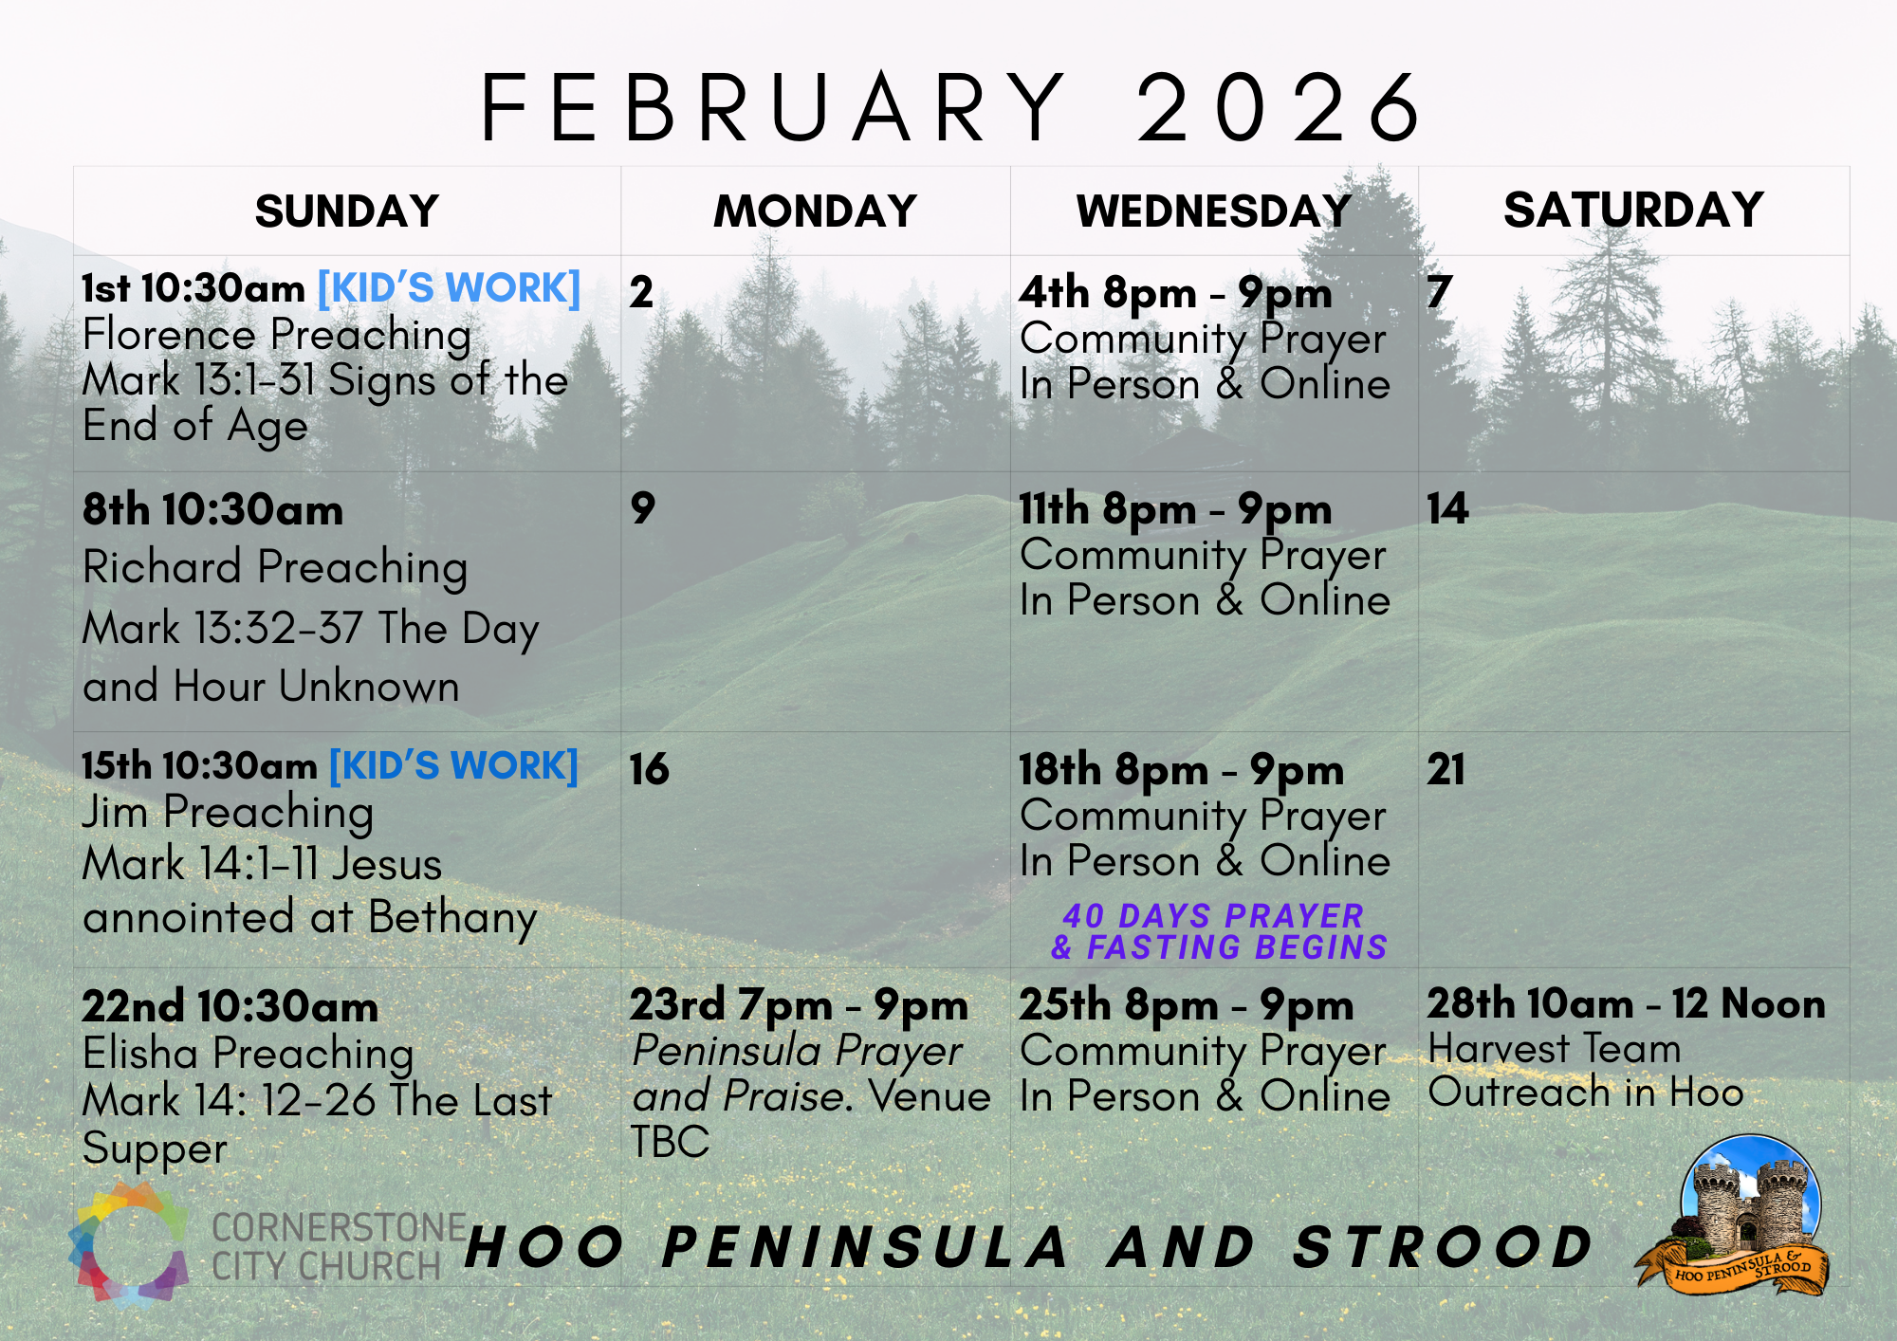

Slide 42
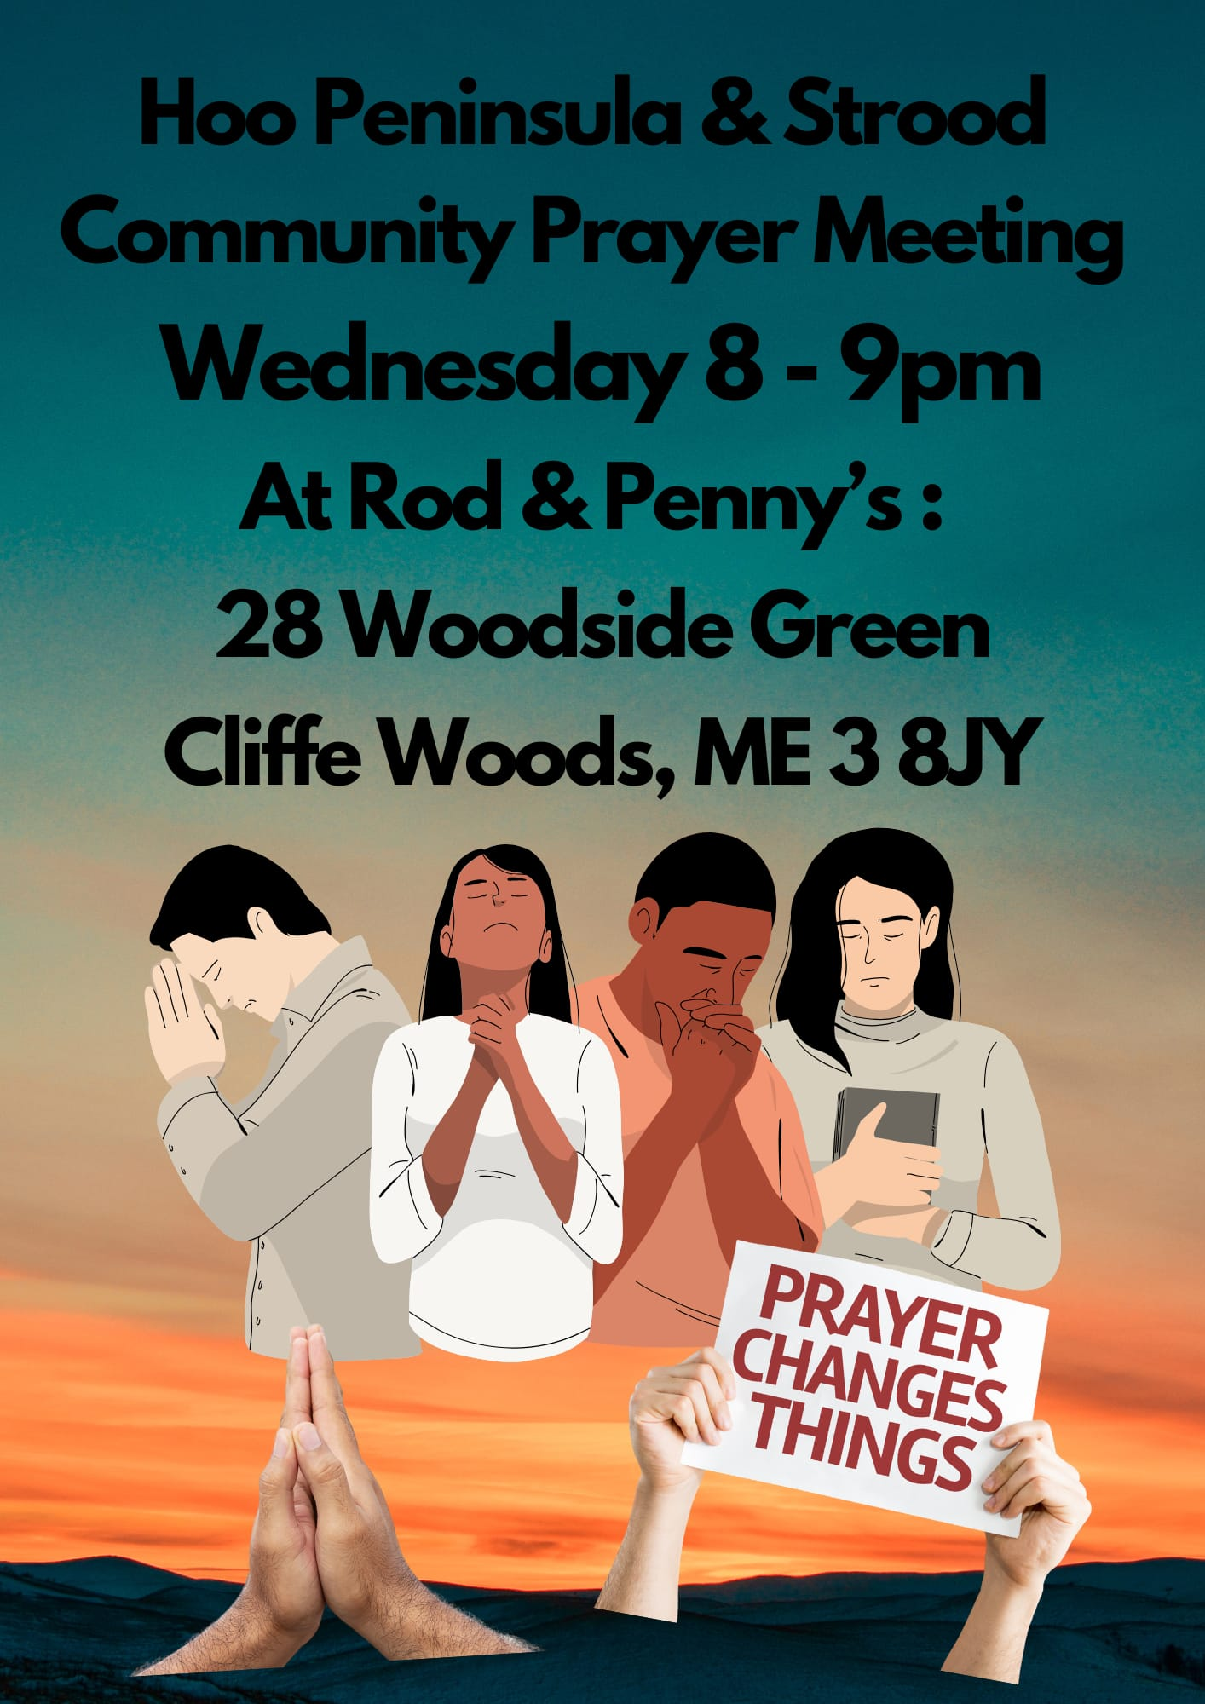

Slide 43
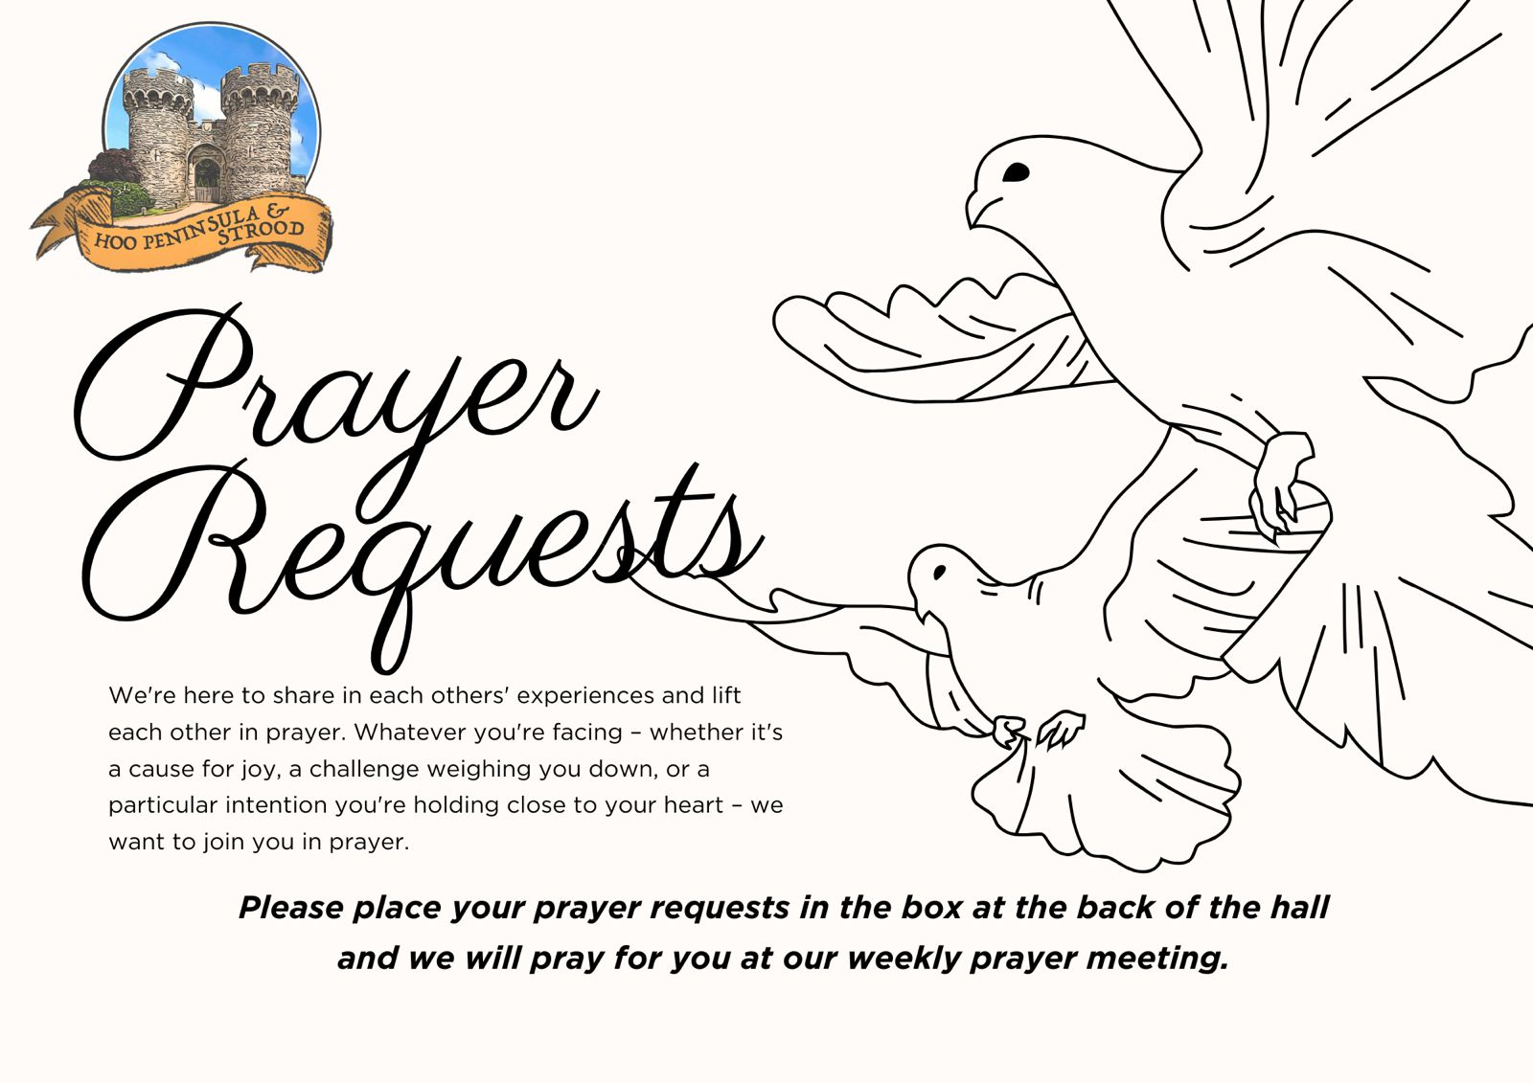

Slide 44
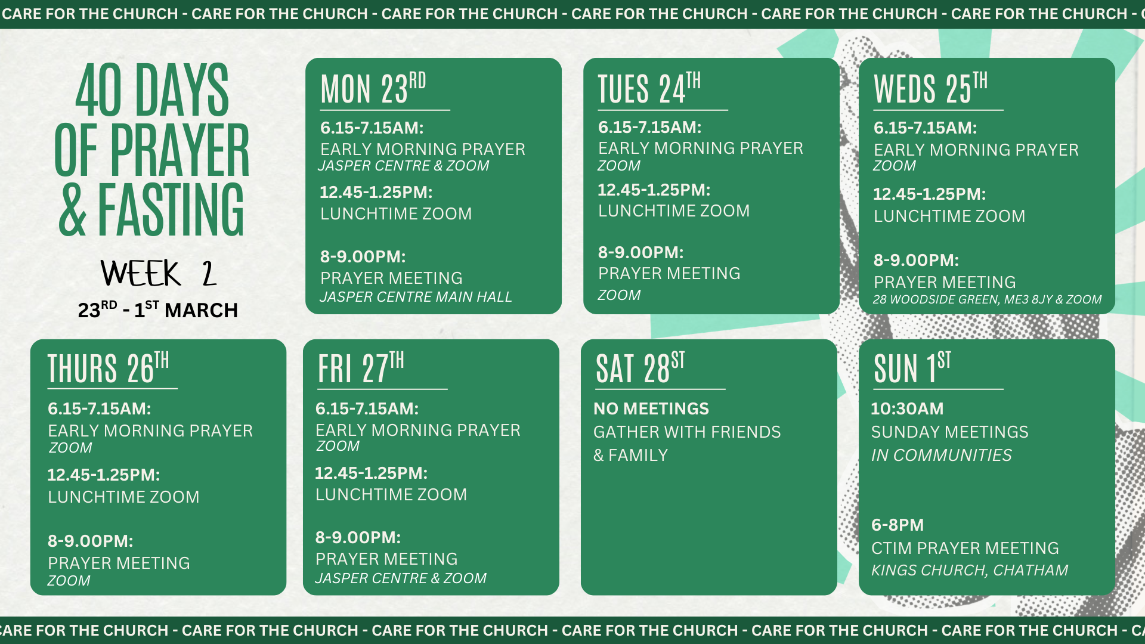

Slide 45
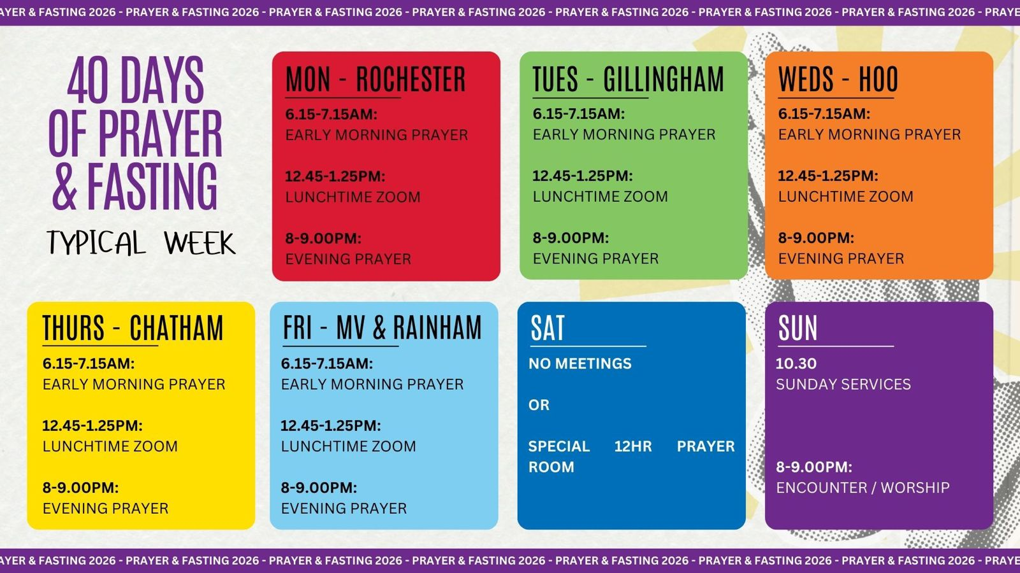

Slide 46


Slide 47
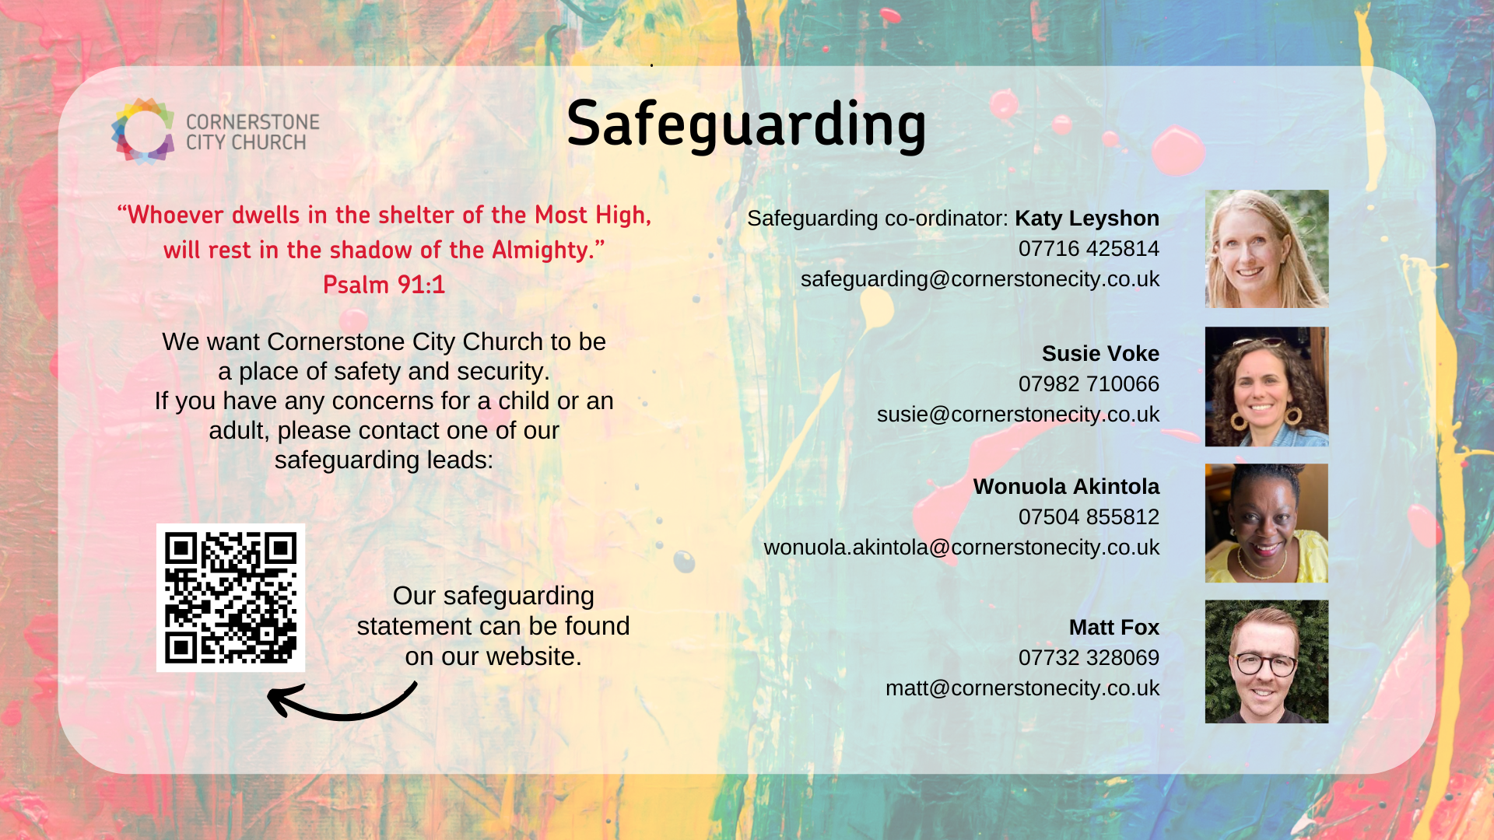

Slide 48


Slide 49


Slide 50
2 Corinthians 14 May the grace of the Lord Jesus Christ, and the love of God, and the fellowship of the Holy Spirit be with us all. And….
Surely goodness and mercy shall follow us all the days of our lives, and we shall dwell in the house of the Lord forever.

